Slide 1
Urban Sound Classification using CNN, SVM, Regression Trees
By
Clyde Clarke

Slide 2
Outline
Problem Statement
Dataset
Sound Classification
Feature Extraction
MFCC
Classification Methods
SVM
Regression Trees
CNN
Evaluation

Slide 3
The UrbanSound Dataset
Created by Justin Salamon & Christopher Jacoby & Juan Pablo Bello
Contains 8732 labeled sound excerpts (shorter than 4s) of real field-recording urban sounds from 10 classes : (1).air conditioner, (2).car horn, (3).children playing, (4). Dog bark, (5). Drilling, (6). Engine idling, (7). Jackhammer, (8) gun shot, (9) siren, and (10.) street music.
Sampling Frequency 44 KHz
Sample Duration ~ 4s
Sound Samples 8972
The largest free urban sound dataset.

Slide 4
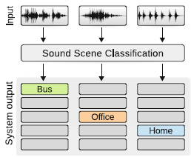
Sound Classification

Slide 5
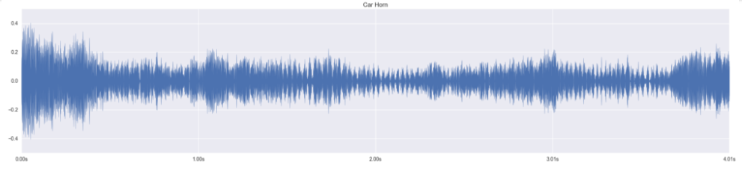
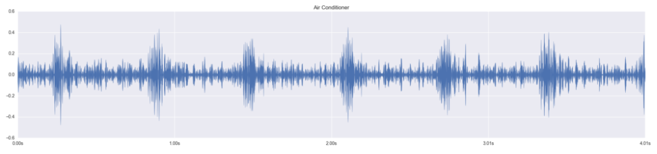
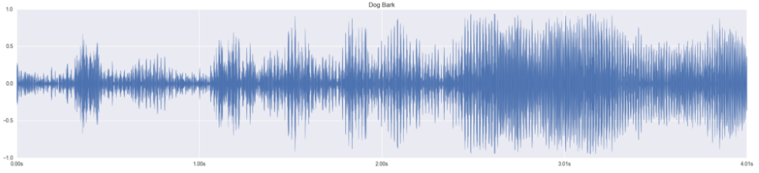
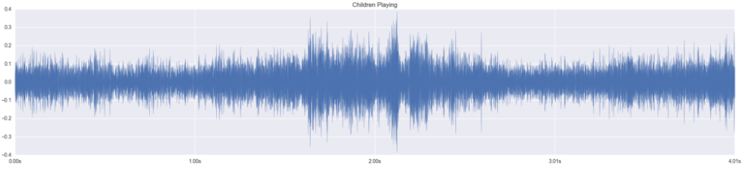
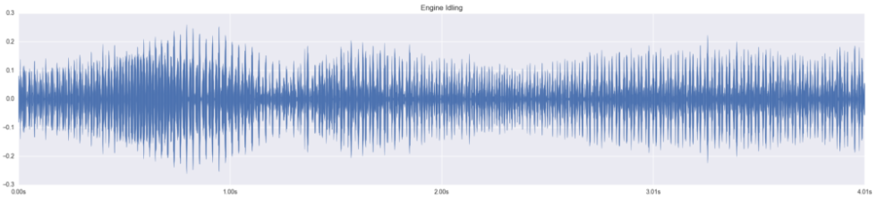
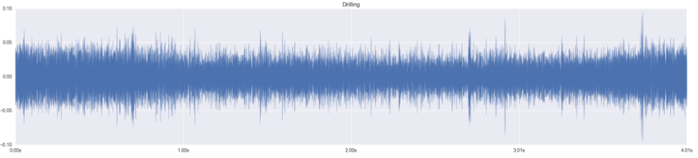
Sound Classes
Car horn
Air conditioner
Dog barks
Children playing
Engine idling
Drilling

Slide 6
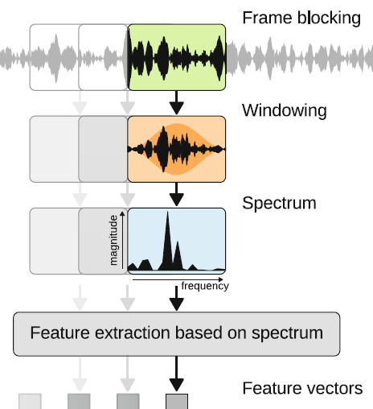
Feature Extraction
Frame Blocking
Segment signal into regions that retain small scale changes
Windowing
Done to prevent gibbs phenomena at frame edges that would corrupt spectral analysis
Spectrum
Any number of techniques can be used to extract features from signal
DWT
FFT
DCT

Slide 7

Preemphasis: compensates for spectral tilt (speech production/microphone channel)
Windowing: suppression of transient effects in short-term segments of
signal
|FFT|²: energy spectrum (phase is discarded)
MEL Filter bank: MEL scale – models logarithmic perception of frequency
in humans; triangular filters – dimensionality reduction
Davis & Mermelstein,1980

Slide 8
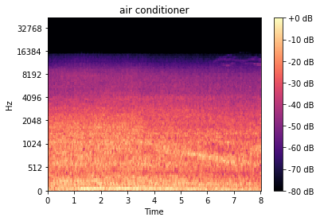
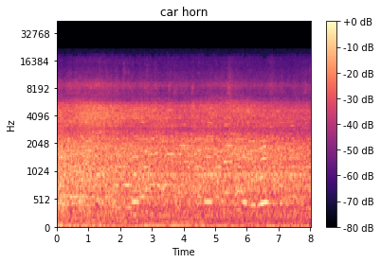
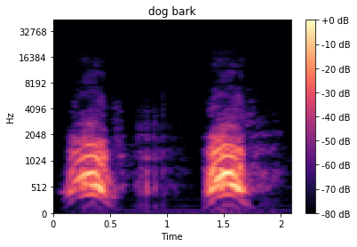
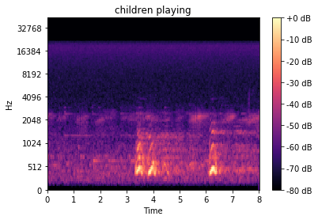
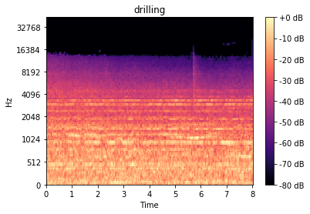
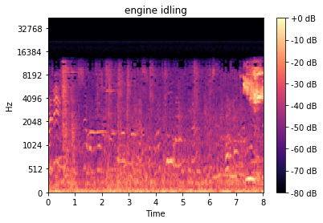
MFCC Features

Slide 9
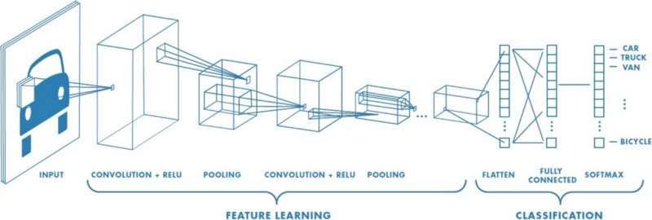
Convolutional Neural Network Architecture

Slide 10
Training and Processing
Due to variable sample length wave files were zero padded
Training was done using an 80/20 split of the data
Network was trained using adam optimization
A batch size of 32 and 100 epoch was used to train two convnet architectures

Slide 11
CNN Architecture 1
_________________________________________________________________
Layer (type) Output Shape Param #
=================================================================
conv2d_1 (Conv2D) (None, 26, 124, 64) 1664
_________________________________________________________________
conv2d_2 (Conv2D) (None, 24, 122, 32) 18464
_________________________________________________________________
conv2d_3 (Conv2D) (None, 22, 120, 16) 4624
_________________________________________________________________
flatten_1 (Flatten) (None, 42240) 0
_________________________________________________________________
dense_1 (Dense) (None, 10) 422410
=================================================================
Total params: 447,162
Trainable params: 447,162
Non-trainable params: 0
_________________________________________________________________

Slide 12
CNN Network Architecture 2
Layer (type) Output Shape Param #
=================================================================
conv2d_4 (Conv2D) (None, 28, 126, 32) 320
_________________________________________________________________
conv2d_5 (Conv2D) (None, 26, 124, 32) 9248
_________________________________________________________________
max_pool2d MaxPooling2 (None, 13, 62, 32) 0
_________________________________________________________________
dropout_1 (Dropout) (None, 13, 62, 32) 0
________________________________________________________________
conv2d_6 (Conv2D) (None, 11, 60, 64) 18496
_________________________________________________________________
conv2d_7 (Conv2D) (None, 9, 58, 64) 36928
_________________________________________________________________
max_pool2d MaxPooling2 (None, 4, 29, 64) 0
_________________________________________________________________
dropout_2 (Dropout) (None, 4, 29, 64) 0
_________________________________________________________________
flatten_2 (Flatten) (None, 7424) 0
_________________________________________________________________
dense_2 (Dense) (None, 256) 1900800
_________________________________________________________________
dropout_3 (Dropout) (None, 256) 0
_________________________________________________________________
dense_3 (Dense) (None, 10) 2570
=============================================
Total params: 1,968,362
Trainable params: 1,968,362
Non-trainable params: 0
_________________________________________________________________

Slide 13
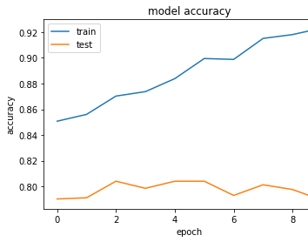
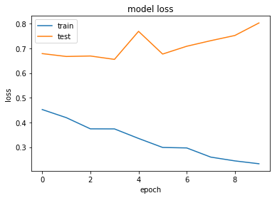
Architecture 1 Evaluation
Class Precision recall f1-score support
0 0.92 0.60 0.73 171
1 0.37 0.54 0.44 79
2 0.62 0.76 0.69 114
3 0.56 0.72 0.63 97
4 0.40 0.46 0.43 116
5 0.84 0.70 0.77 44
6 0.78 0.71 0.74 136
7 0.89 0.69 0.77 169
8 0.75 0.84 0.79 97
9 0.79 0.78 0.79 64

Slide 14
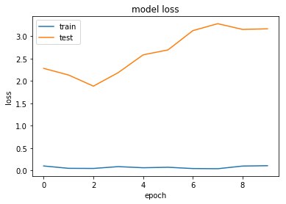
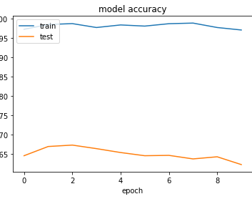
Architecture 2 Evaluation
Class precision recall f1-score support
0 0.73 0.69 0.71 121
1 0.61 0.49 0.54 164
2 0.69 0.55 0.61 150
3 0.31 0.71 0.43 55
4 0.31 0.48 0.38 90
5 0.65 0.86 0.74 28
6 0.72 0.74 0.73 125
7 0.73 0.76 0.75 110
8 0.90 0.73 0.81 151
9 0.88 0.57 0.69 93

Slide 15
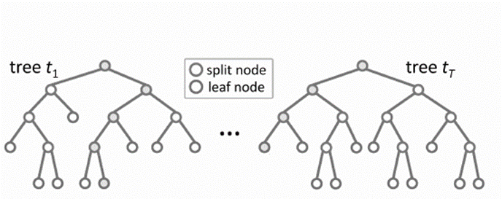
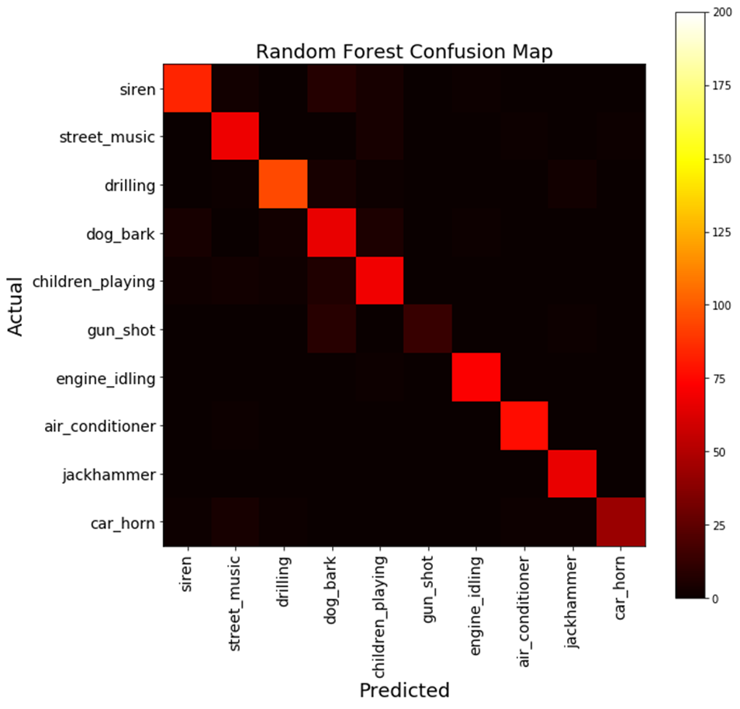
Random Forest
Random forests (RF) are a combination of tree predictors
Each tree depends on the values of a random vector sampled in dependently
The generalization error depends on the strength of the individual trees and the correlation between them
Accuracy
.82

Slide 16
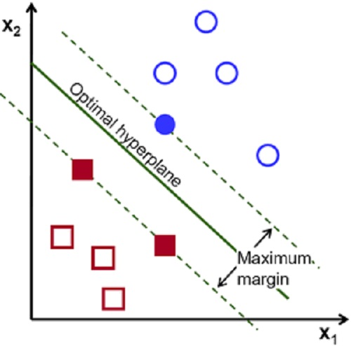
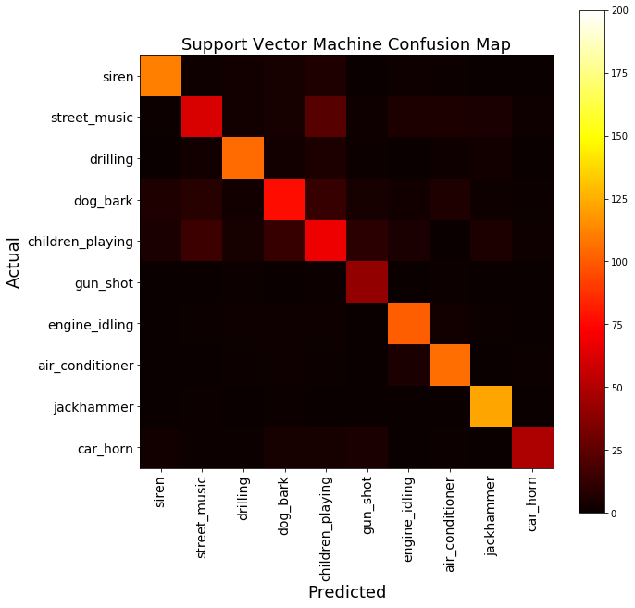
SVM
Large Margin Classifier
Maximizes the distance between decision boundary and support vectors
Kernel
Radial Basis Function
Gamma
.08
Accuracy
.77

